Slide 1
Volume Estimation
Yakunina Kseniia

Slide 2
Methodology:
01
02
03
04
Stocks:
Apple inc., Nike,
Johnson & Johnson
for 5 years
Prediction with SMA with different windows
Adding an additional time-based features
Results Evaluation

Slide 3
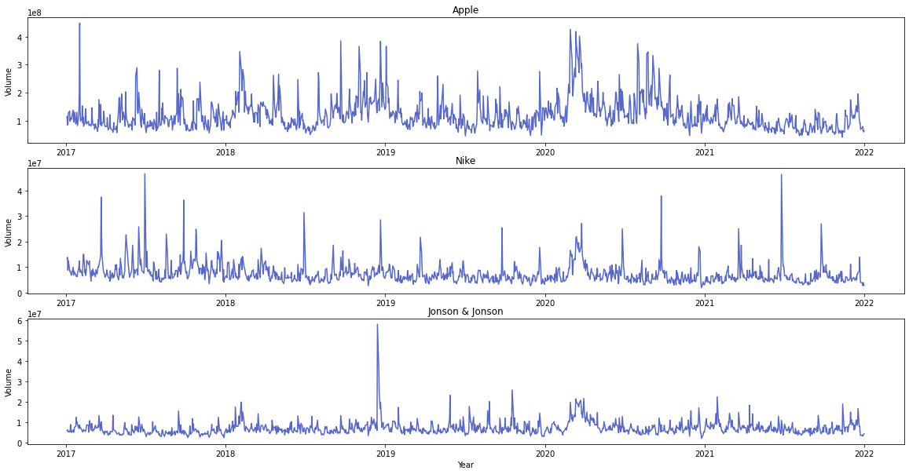
Data

Slide 4
Worked :
Day of the week
Quarter
Day of the month
Simple Moving average with different windows
Not worked :
VWAP - Volume-weighted average price
Day of the Year
Friday marker
New Features

Slide 5
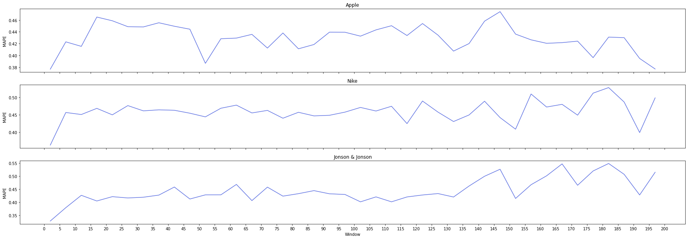
MAPE on In-sample data

Slide 6
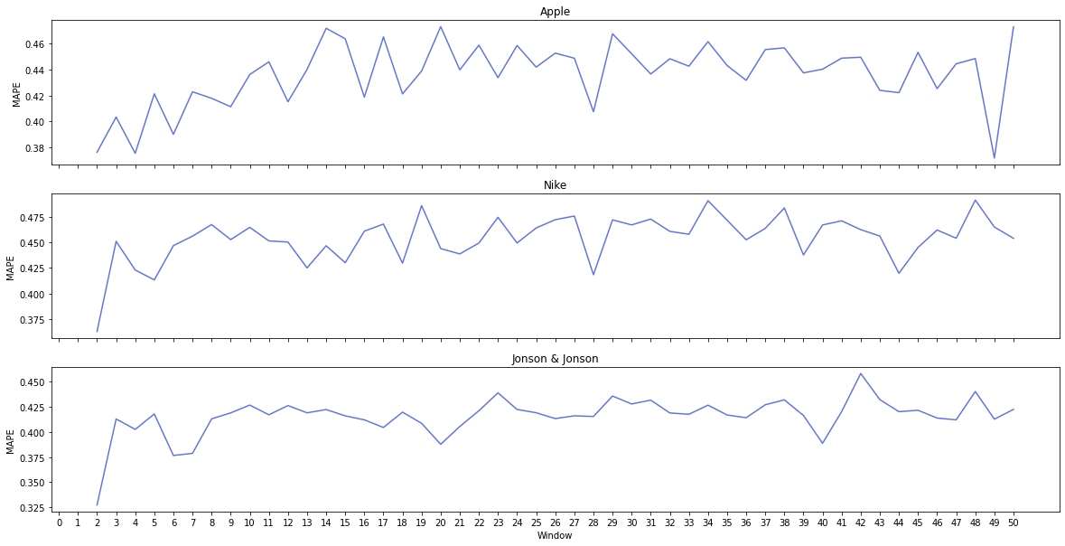
MAPE on In-sample data

Slide 7
Results
OLS model without modification
OLS model with modification
Stock : Apple, R2 : 0.45
Stock : Nike, R2 : 0.81
Stock : J&J, R2 : 0.89
Stock : Apple, R2 : 0.47
Stock : Nike, R2 : 0.84
Stock : J&J, R2 : 0.91
Apple
Nike
Jhonson & Jhonson
Window | R^2 | F-test | MAPE test data
2 | 0.85 | 602.0 | 0.11
6 | 0.66 | 203.7 | 0.18
12 | 0.6 | 141.9 | 0.2
18 | 0.56 | 128.1 | 0.24
25 | 0.54 | 119.9 | 0.23
28 | 0.54 | 117.1 | 0.25
50 | 0.5 | 104.3 | 0.25
100 | 0.5 | 96.0 | 0.26
Window | R^2 | F-test | MAPE test data
2 | 0.78 | 358.8 | 0.14
6 | 0.48 | 94.8 | 0.22
12 | 0.41 | 71.7 | 0.25
18 | 0.38 | 63.5 | 0.29
25 | 0.37 | 60.4 | 0.28
28 | 0.37 | 59.4 | 0.28
50 | 0.36 | 58.0 | 0.27
100 | 0.37 | 56.4 | 0.27
Window | R^2 | F-test | MAPE test data
2 | 0.82 | 458.3 | 0.13
6 | 0.63 | 176.4 | 0.17
12 | 0.57 | 138.8 | 0.2
18 | 0.56 | 130.6 | 0.23
25 | 0.56 | 127.2 | 0.17
28 | 0.55 | 125.7 | 0.18
50 | 0.54 | 119.3 | 0.21
100 | 0.54 | 110.0 | 0.23

Slide 8
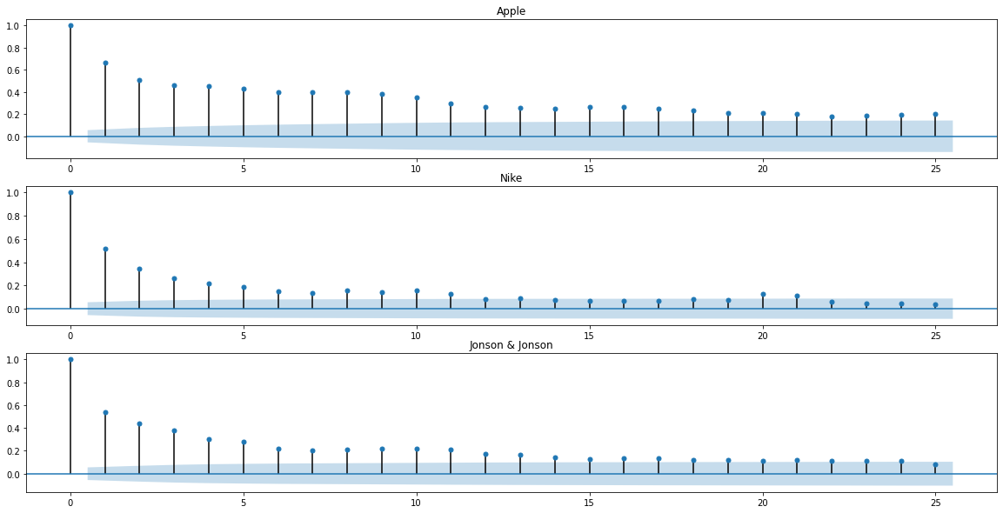
Autocorrelation plot

Slide 9
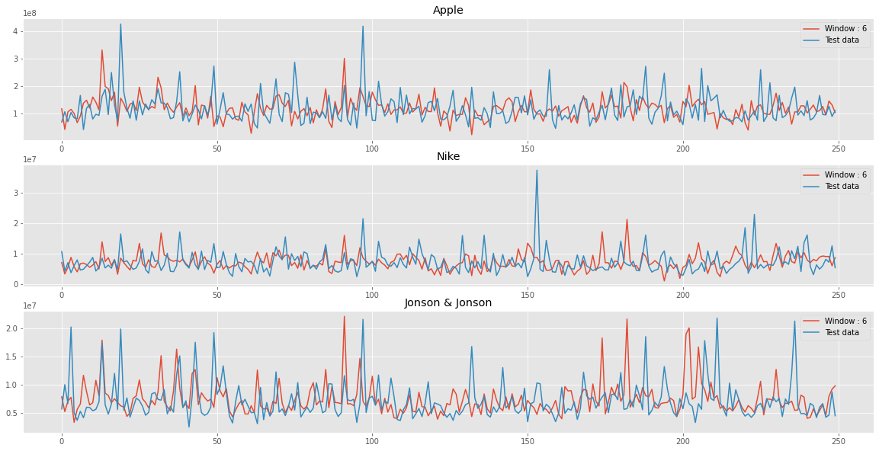
Prediction on test data

Slide 10
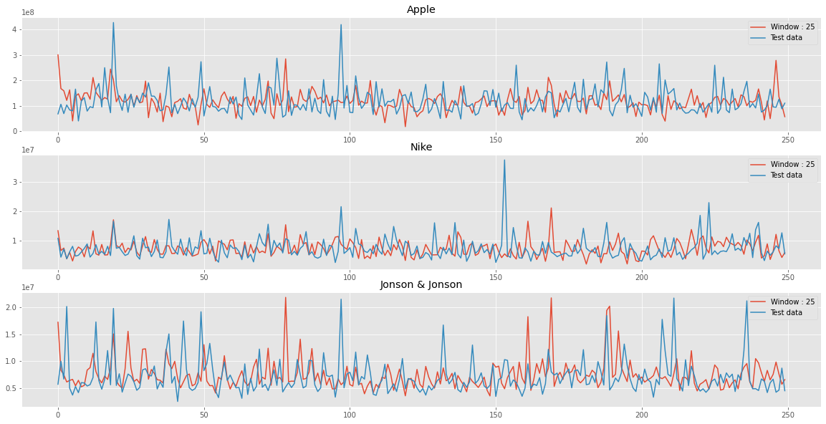
Prediction on test data

Slide 11
Conclusion
It is beneficial to use timestamp markers like “day of the week” and “day of the month” for volume estimation.
The good window day of volume estimation is 2,6 and 25.
The moving average of window 2 don’t removes noise from data and don’t reveal the trend.
The 6 and 25 window have very similar results, but 25 prediction on out-sample data better follows the tops.

Slide 12
References
https://flextrade.com/wp-content/uploads/2015/01/Predicting-Intraday-Trading-Volume-and-Percentages.pdf
https://towardsdatascience.com/an-algorithm-to-find-the-best-moving-average-for-stock-trading-1b024672299c

